Slide 1
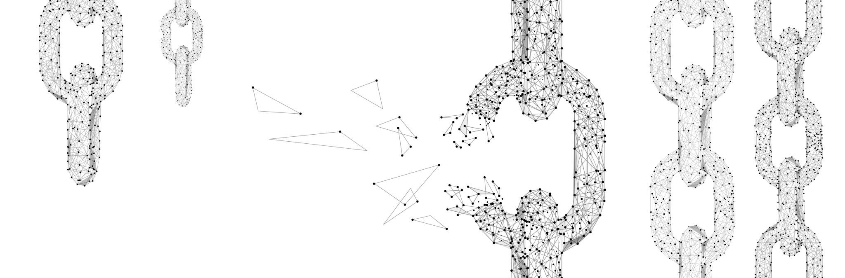
DETECTION OF FABRICATED CERTIFICATES USING BLOCK CHAIN
Project Guide: Preeti Prasada
BATCH 14
K SIDDHARTH
L NEEKSHITH REDDY
S SAI SHARAN

Slide 2

contents
Abstract
Introduction
Roles and Responsibilities
Reasons for Literature
Literature Forms
Sources of Literature
Modules Description
Design
Summary
Project features
Architecture
Algorithms
Execution
Existing System
Proposed System

Slide 3
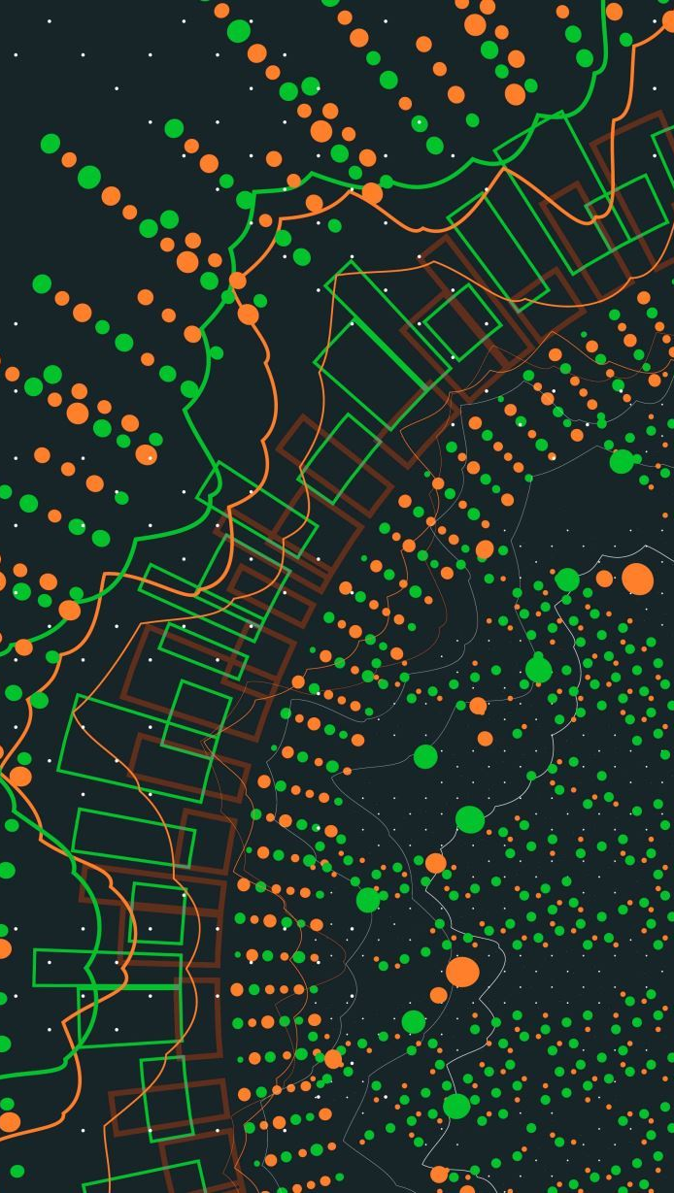
ABSTRACT
In the digital world, each and everything is digitalized in which the certificate of SSLC, HSC, and academic certificate are digitalized in the educational institution and provided to the students.
For the organization and institution, verification and validation of certificates are tedious and cumbersome.
Our project will help to store the certificate in the blockchain system and provide security.
First, the paper certificates are converted into digital certificates. Then the certificates are store in blockchain. And these certificates are validated by using the application. By using blockchain technology we can provide a more secure and efficient digital certificate validation.

Slide 4
InTRODUCTION
As manual verification process takes much time and effort, the objective of this project is to simplify and amplify the process without compromising the data security.
Here the certificates are auto-validated using block chain technology.
Block chain technology provides data safety and security features like data integrity and confidentiality which play an essential role in this project

Slide 5
ROLES AND RESPONSIBILITIES
Block chain creation and Saving certificate with digital signature > SIDDHARTH
Verify certificate module and USER-INTERFACE DEVELOPMENT > SAI SHARAN
TESING AND DOCUMENTATION >L NEEKSHITH REDDY

Slide 6
EXISTING SYSTEM
Manual Checking with the issued organization
•Checking previous records
•Cross checking the data on the certificates with that of the data available with the organization
•Some are available on the internet and can be unlocked with a public key
•DISADVANTAGES:
Time taking
Costly

Slide 7
PROPOSED SYSTEM
In this proposed system the academic, sports certificates are converted into digital certificates.
•Then the certificates are added with the hash values generated for the digital certificate and store it into the blocks.
•The institution registers the student details in our interface by providing details like name, email id and these are stored in the database
The certificate issued by the registrar is stored in the application and they form a blockchain.
•The employer or verifier can validate the certificate by entering the student details.
•The certificate is validated rapidly. Provide accurate and reliable information.

Slide 8

REASONS FOR LITERATURE
The main reasons which motivates us to do this project are
To discover what initiatives or hypotheses were already in existence on the subject of digital signatures, block chain, digital certificate etc.
In order to create a superior version and to comprehend the shortcomings in the earlier efforts. To look for upgraded features to include in certificate verification.
Another key reason is to prevent circulation of fake documents, which has become common in this digital world.

Slide 9
Literature forms
IEEE conference
Title: Certificate validation using blockchain
Authors: A.Gayathiri, J.Jayachitra, Dr.S.Matilda
IRJET
Title: A REVIEW ON IMPLEMENTATION TECHNIQUES OF BLOCKCHAIN ENABLED SMART CONTRACT FOR DOCUMENT VERIFICATION
Authors: M. Hamitha Nasrin, S. Hema lakshmi, Prof G. Ramsundar
BLOG POST
Title: How To Build A Blockchain In Python
Author: Dante Sblendorio

Slide 10
Sources of literature
IEEE-conference Insights
Digital Certificate Creation: In this, the student certificates are converted into digital certificates. The academic certificate and sports certificate are issued by the institution are stored in the database.
Hash Code Generation
Digital certificate: Validation In this, the created digital certificate is validated. Certificates that are stored in the blockchain are validated by matching the hash value.
IRJET
Digital Signature: A digital signature is an electronic, encrypted, stamp of authentication on digital information such as email messages, macros, or electronic documents.
Smart contract: The data stored in smart contract can be used to record information, fact, associations, balances and any other information needed for the implementation logic for real world contracts.
Blog Post:
Fundamentally, the data stored in a blockchain must have the following characteristics: Immutable, Persistent (no loss of data) and Distributed.
Each block contains: index, transaction, timestamp, previous hash, nonce(32-bit number for base calculations)

Slide 11

MODULES DESCRIPTION
Modules Description
Creating Block chain Structure: To create a block chain structure using python as programming language.
Save Certificate with Digital Signature: In this section, the administrator may add new students to the system and upload their academic credentials; the program will then transform the certificates into digital signatures and store them in a distributed ledger.
Verify Certificate: In this section, a verifier, company, or administrator will collect a student's certificate, upload it to the program, and then use the digital signature generated by the application to verify the certificate against the Blockchain database. If a match is discovered, the verifier will be presented with the student's full profile; otherwise, the certificate will be deemed forged.
Testing for its functionatilities: The model is tested for any errors with some sample data

Slide 12
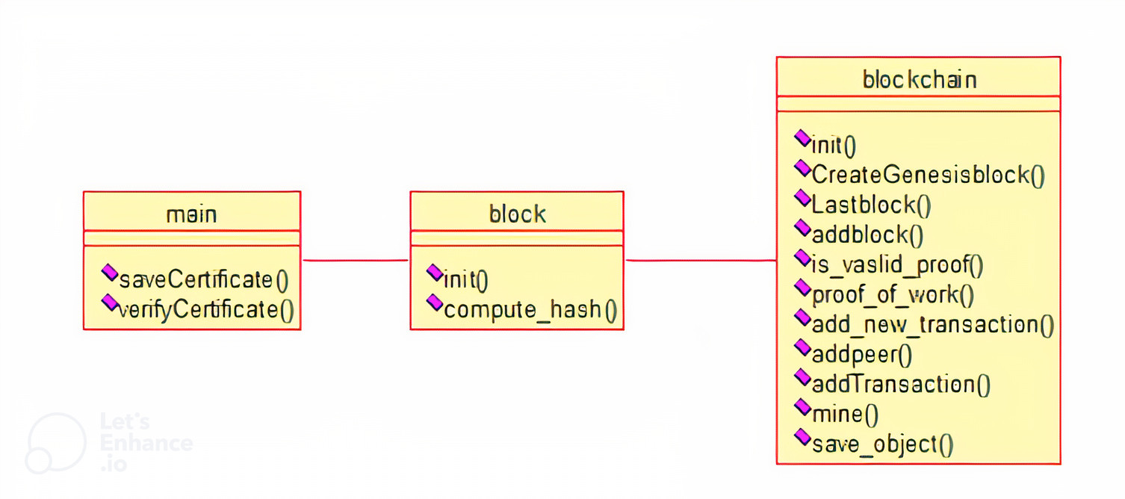
Design
Class diagram

Slide 13
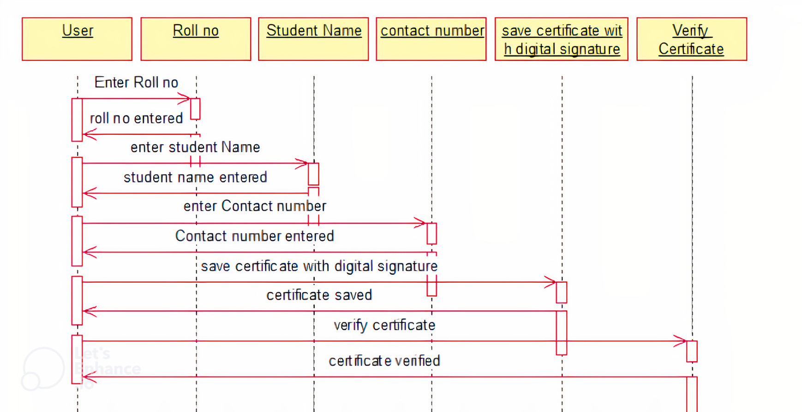
Sequence diagram

Slide 14
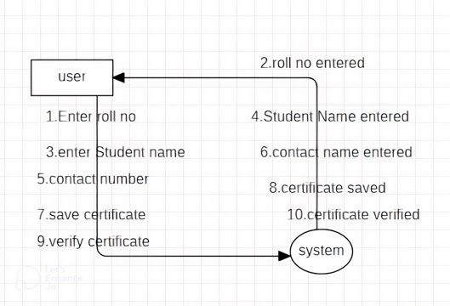
Dataflow diagram

Slide 15
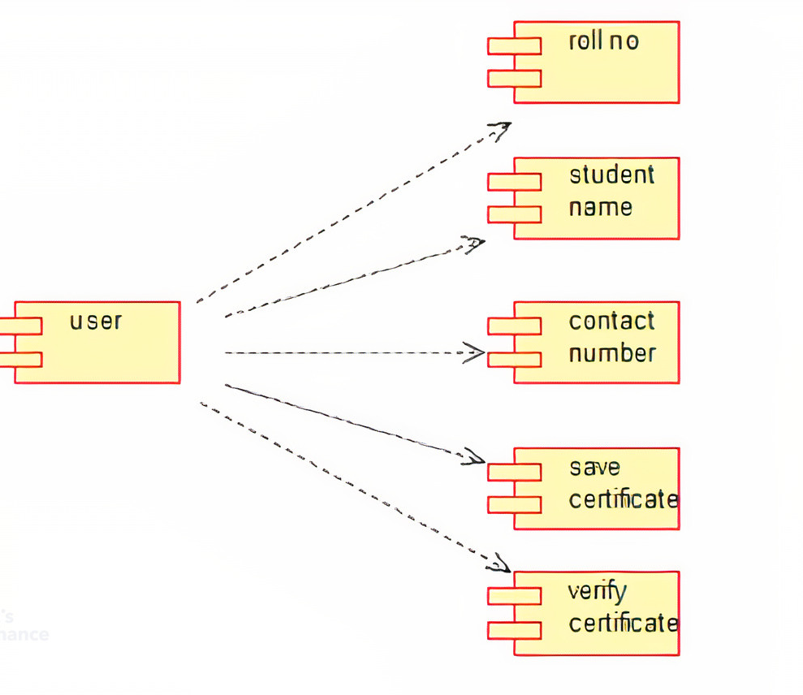
Component diagram

Slide 16
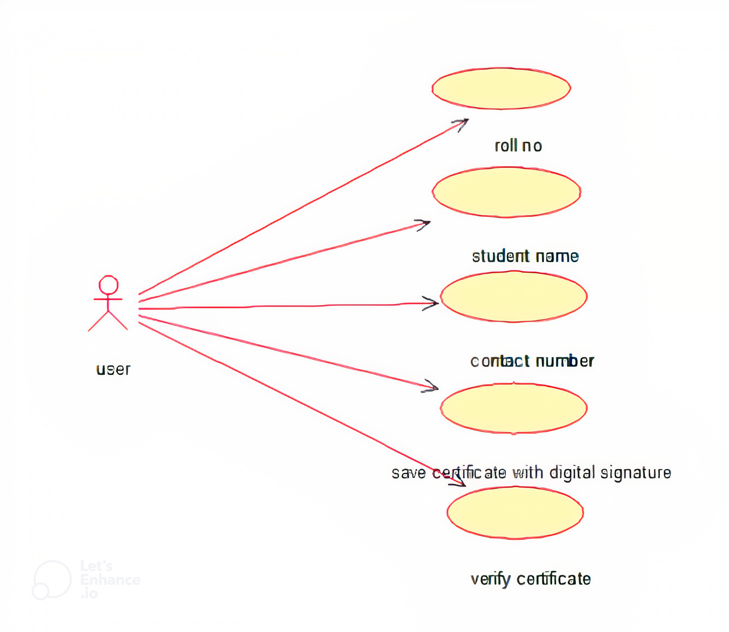
Usecase diagram

Slide 17
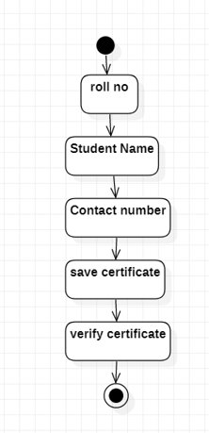
Activity diagram

Slide 18
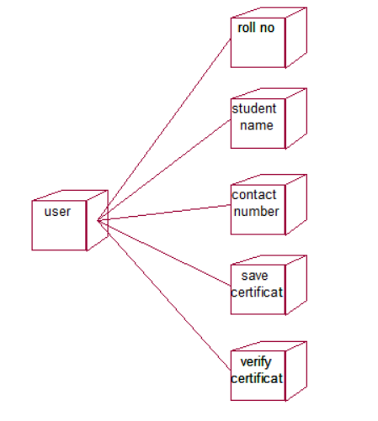
Deployment diagram

Slide 19
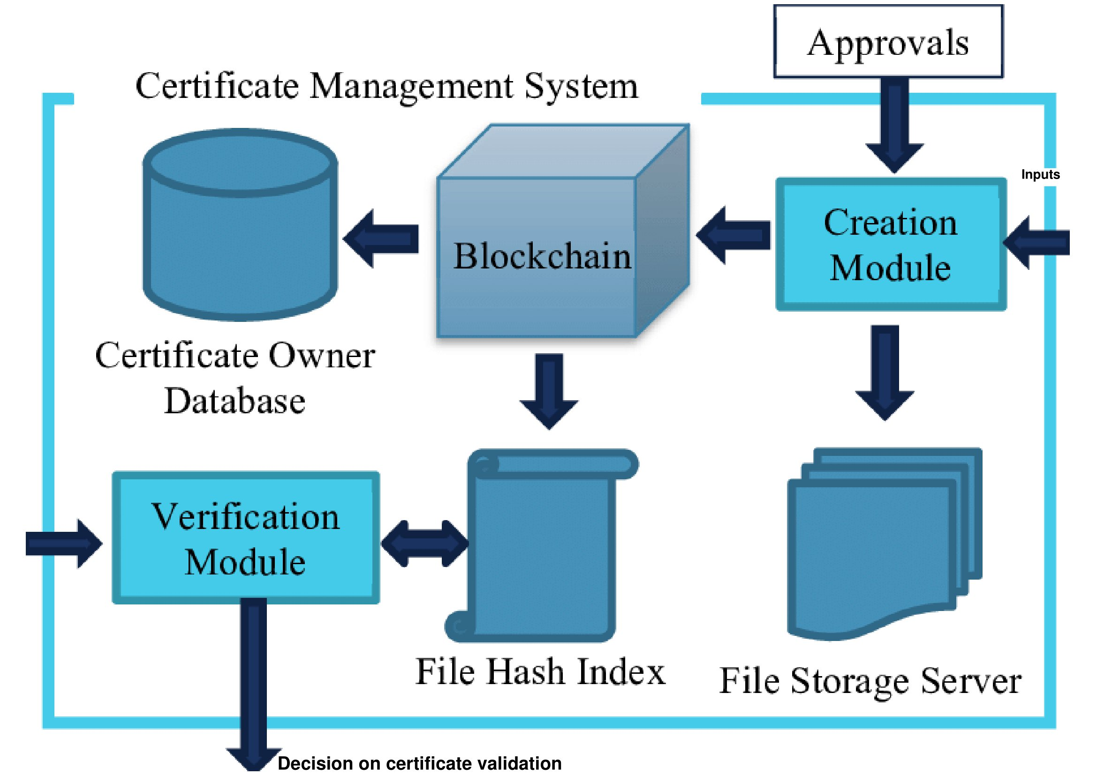
Architecture diagram

Slide 20
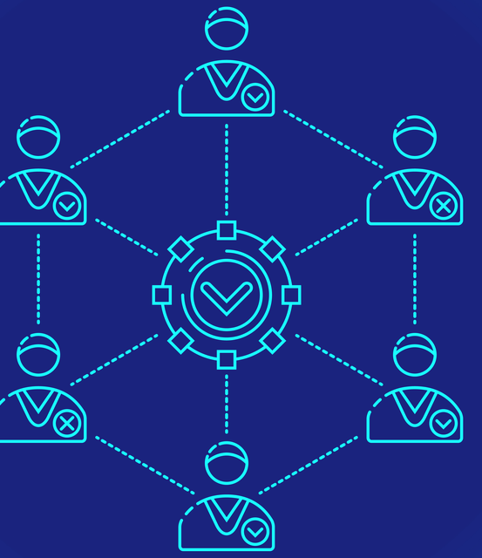
Algorithms used in the project
Consensus Algorithm:
Consensus algorithms are a decision-making process for a group, where individuals of the group construct and support the decision that works best for the rest of them. It’s a form of resolution where individuals need to support the majority decision, whether they liked it or not.

Slide 21
Hashing algorithm-sha 256
Hashing refers to the process of generating a fixed-size output from an input of variable size using the mathematical formulas known as hash functions. This technique determines an index or location for the storage of an item in a data structure.
SHA-256 (Secure Hash Algorithm 256-bit) is a cryptographic hash function that produces a 256-bit (32-byte) hash value. It is one of the most commonly used hash functions in various security applications, including digital signatures, password storage, and data integrity checking.
Our suggested model uses this cryptographic algorithm to ensure that no one else can access the user's identification information and that it will remain secure when the user enters it.

Slide 22
Digital signature and certificates
A digital signature is a mathematical technique used to validate the authenticity and integrity of a digital document, message, or data. It is created using a digital signing algorithm that uses a private key to encrypt a hash value of the data being signed. The resulting encrypted data, along with the public key used to decrypt it, forms the digital signature. Digital signatures are commonly used in email, electronic documents, and software distribution to verify the identity of the sender and to ensure the message has not been tampered with in transit.
digital certificate is a digital document that serves as an electronic credential, which verifies the identity of an entity (such as a person, organization, or website) and enables secure communication over the internet. A digital certificate contains information about the entity, such as the name, public key, expiration date, and the name of the CA that issued the certificate. When a user attempts to establish a secure connection with a website or email server, their browser checks the digital certificate to verify the authenticity of the website or email server, and to ensure that the communication is encrypted and secure.
a digital signature is used to verify the authenticity and integrity of data, while a digital certificate is used to verify the identity of the sender or receiver and to ensure secure communication over the internet.

Slide 23
PROJECT FEATURES
To develop a system which can validate the authenticity of the certificate.
To add a security feature and provide safety for the certificates of customers.
Used to validate certificates.
Easily identify duplicates.
Can be utilized by different organisations.
Highly secure and reliable due to presence of Block Chain.

Slide 24
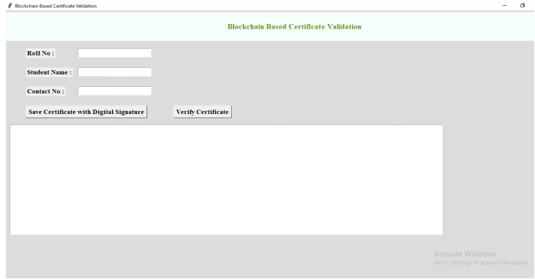
EXECUTION SCREENSHOTS

Slide 25
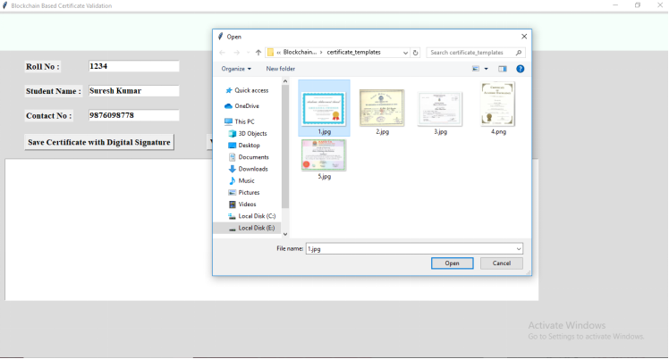
Entering details

Slide 26
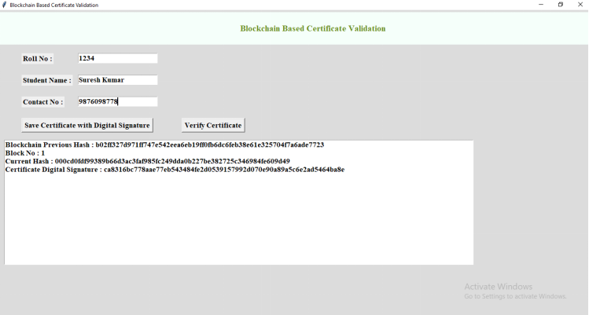
Saving details

Slide 27
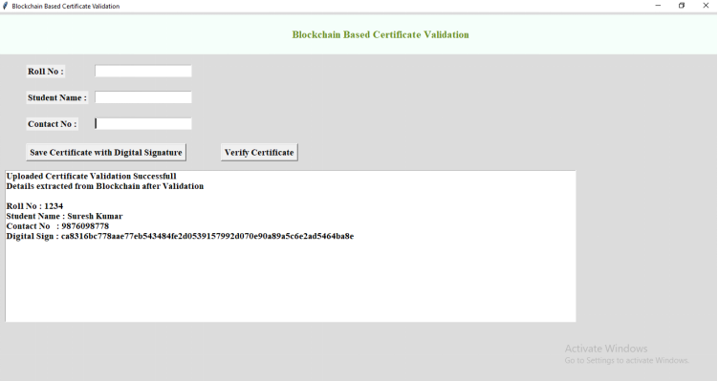
Verifying data

Slide 28
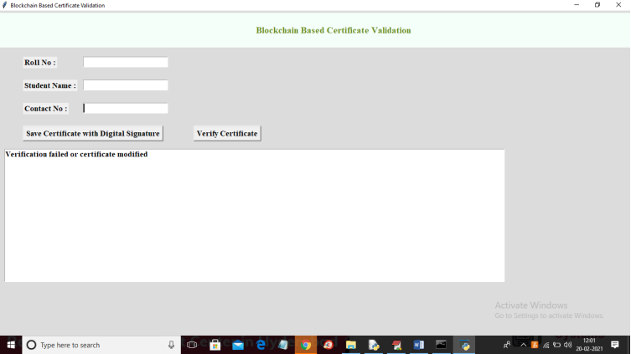
Fabricated data

Slide 29

SUMMARY
In this proposed system the academic, sports certificates are converted into digital certificates.
Then the certificates are added with the hash values generated for the digital certificate and store it into the blocks.
The institution registers the student details in our interface by providing details like name, email id and these are stored in the database

Slide 30
Advantages:
The certificate issued by the registrar is stored in the application and they form a blockchain.
The employer or verifier can validate the certificate by entering the student details.
The certificate is validated rapidly. Provide accurate and reliable information.
More Security
Confidentiality is preserved
Highly reliable
Cost efficient
Modification of data is not possible

Slide 31

THANK YOU
BY BATCH 14
K SIDDHARTH
L NEEKSHITH REDDY
S SAI SHARAN

